Slide 1
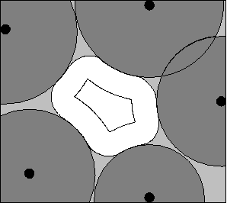
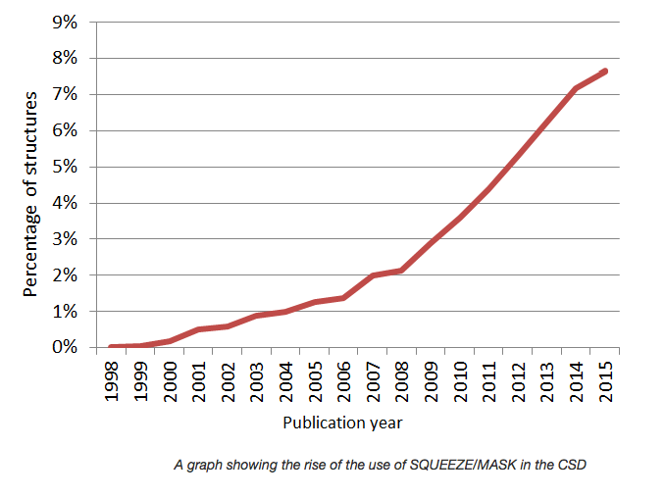
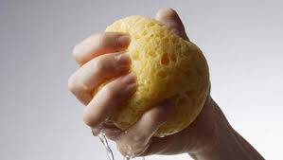
(check)CIF, SHELXL-2014, SQUEEZE
Ton Spek
Utrecht University
The Netherlands
SHELX Workshop, ACA-Denver, July 22, 2016

Slide 2
The CIF Standard & Validation
CIF was created around 1990 by an IUCr committee for data exchange and archival.
One of the early adopters was SHELXL97.
Acta Cryst. C pioneered its use for publication data and text entry.
Acta Cryst. C pioneered automated checking of data consistency and data completeness.
Today, an IUCr-checkCIF report is an essential requirement for publication in most journals.

Slide 3
FCF-Validation Added
A SHELX97 style CIF only reports the numerical results of a structure determination (i.e. Space group, model parameters and R-values)
The associated ‘CIF-style’ FCF file allows for a detailed analysis of the fit of the structure model (Fcalc) to the reflection data (Fobs)
Together, the CIF + FCF offer the authors interpretation of the experimental data

Slide 4
Archival of the Experimental Data
For a proper review and archival for possible follow-up research we would need at least the deposition of the unmerged reflection data.
Needed to resolve issues concerning missed symmetry, missed twinning, hydrogen atoms, main molecule disorder, disordered solvents etc.
The ‘embedding’ mechanism was choosen to include the unmerged reflection data in the CIF as a comment with a proper data name, to be ignored in most applications such as graphics and geometry calculations.

Slide 5
Final .res & .hkl Embedding
Two general data names were introduced for the inclusion of the refinement and reflection details _iucr_refine_instructions_details and _iucr_refine_reflections_details resp.
The .res and .hkl are embedded as text between semicolons (i.e. ‘; <newline> <text> <newline> ;’)
SHELXL2014 introduced its own equivalents: _shelx_res_file & _shelx_hkl_file along with associated checksums for data integrity.
Those embedded data should NOT be edited or removed from the CIF.
Use ‘shredcif’ or PLATON to extract the .res & .hkl

Slide 6
The SHELXL2014 ABIN Instruction
The total electron density in the unit cell can be split up into two parts, rho1 & rho2, with associated contributions to F_{h}(calc): F_{h} (calc) = F_{h}1 + F_{h}2.
F_{h}1 might be associated with the main molecule of interest and F_{h}2 with a disordered solvent region.
Generally, a disorder model takes care of F_{h}2.
Optionally, the F_{h}2 part can be calculated using an external program and read by SHELXL from a .fab file
The ABIN instruction informs SHELXL2014 to search for and read the external .fab file with H,K,L,A_{h}2,B_{h}2.

Slide 7
The Disordered Solvent Problem
SHELXL2014 offers an extensive set of options to model and refine disordered solvents. This is the preferred approach in most known solvent disorder cases.
In cases of multiple unknown solvent mixtures and smeared density, an elaborate disorder model might not work satisfactorily.
In such cases the SQUEEZE approach with an externally determined solvent contribution might result in a satisfactory main molecule refinement

Slide 8
PLATON/SQUEEZE
The current implementation of the SQUEEZE tool to handle disordered solvents is the third generation of a method published by us more than 25 years ago.
Interfacing with SHELXL2014 refinement solves many earlier issues with SHELX76 & SHELXL97 using .res & .hkl data. [e.g. Modification of the observed data]
Documentation of the recommended procedure: A.L.Spek (2015) Acta Cryst. C71, 9-18
http://www.platonsoft.nl/PLATON_HOW_TO.pdf
Example: Comparison of disorder model <> SQUEEZE

Slide 9
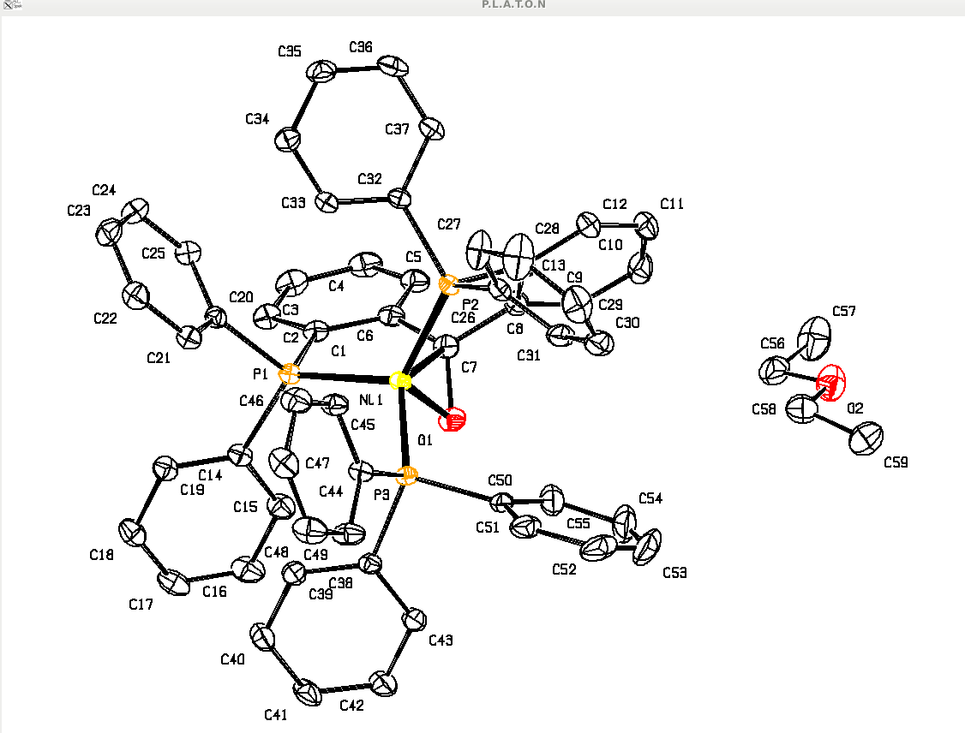
Example
P21/c, 150K
R = 0.0386
wR2 = 0.0966
S =1.037
Diethyl Ether
Disordered over
Inversion centre
PART -1
Organometallics (2015), 34,2710-13

Slide 10
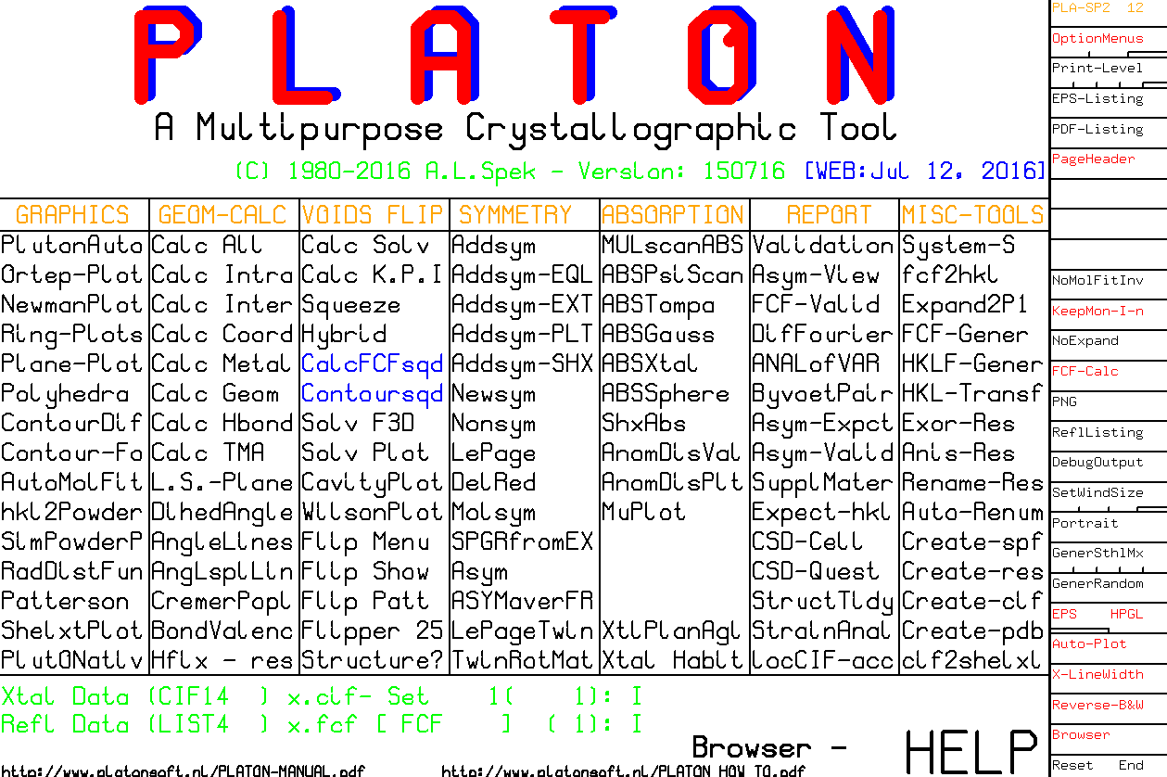
⬅

Slide 11
Definition of VOIDS (white area): roll sphere with radius 1.2 A
In this case there are two solvent accessible voids with
Volume 177 A**3 in the unit cell
SQUEEZE uses this area as a mask to recover the density
In the white area from the difference density map by
Iterative back-Fourier transformation into F_{h}2 (.fab)

Slide 12
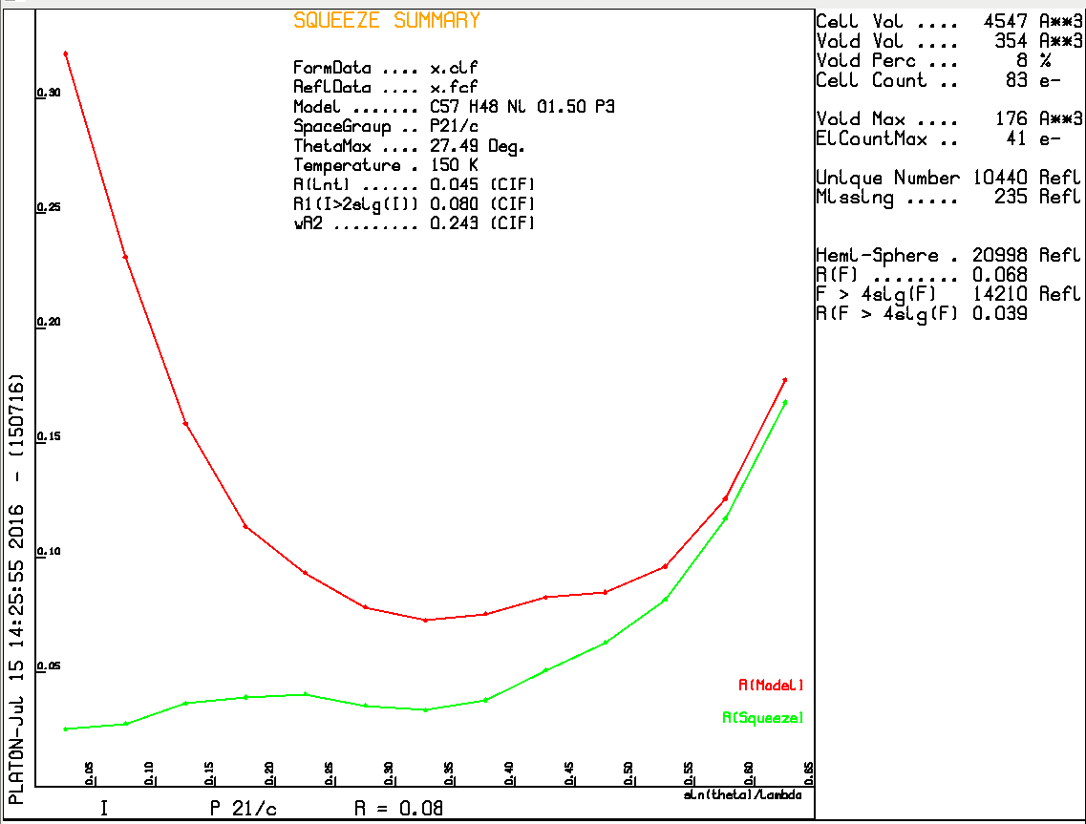
Without Solvent Contribution
With Solvent Contribution

Slide 13
- The _sq.ins file is the original .res (from .cif) + ABIN Instruction
- The _sq.hkl file is the original .hkl (from .cif)
- The _sq.fab file (created by SQUEEZE) includes after the last
reflection info about the SQUEEZE job i.e._sq.sqf & _sq.sqz
Note: PLATON/SQUEEZE does NOT refine the Model Parameters

Slide 14
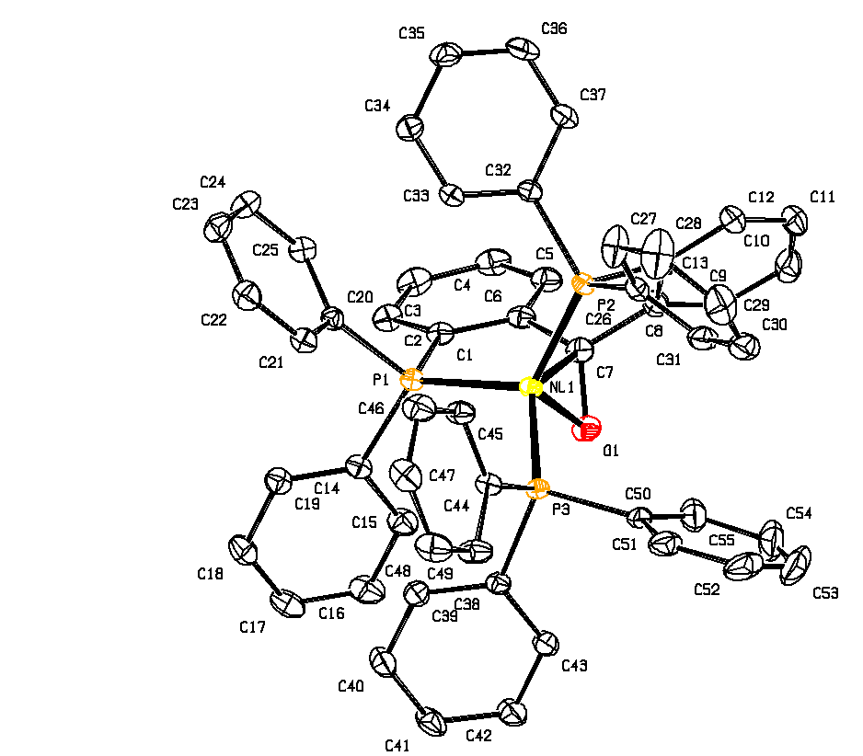
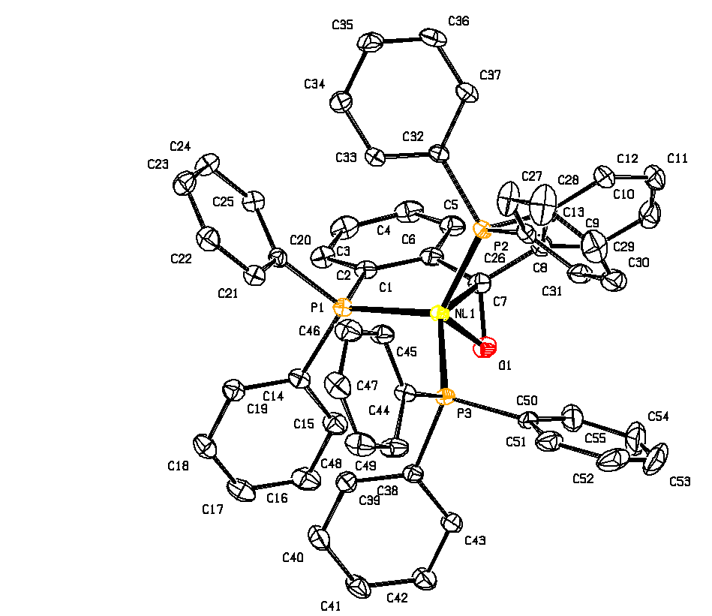
Comparison
R₁ = 0.0386, wR₂ = 0.0966
S = 1.037, 42 electrons
C-C BP = 0.0036 Angstrom
R₁ = 0.0383, wR₂ = 0.0960
S = 1.044, 41 electrons
C-C BP = 0.0035 Angstrom
Disorder Model Diethyl Ether
Squeeze Model DiethylEther

Slide 15
The Proper use of the SQUEEZE Tool
It is important that the final CIF archives both the details of the SQUEEZE calculation and the unmerged reflection data.
The SQUEEZE details are appended to the .fab file
SHELXL2014 offers, by embedding the .res, .hkl & .fab data, all what is needed for that.
In that way, the calculations can be reconstructed and/or alternative refinement models attempted.

Slide 16
Summary of SQUEEZE + SHELXL2014
Refine a non-solvent model with name.ins & name.hkl (Include ACTA record, NO LIST 6) .
Run PLATON/SQUEEZE, based on name.cif & name.fcf from 1 as ‘platon –q name.cif’.
Continue SHELXL refinement with the files name_sq.ins, name_sq.hkl & name_sq.fab from 2 as ‘(shel)xl name_sq’
Inspect the .lis & .lst files and Validate

Slide 17
SQUEEZE Disordered Solvent + Twinning
Step 1: SHELXL2014 refinement based a name.ins (that should include ‘ACTA’, ‘LIST 8’, ‘BASF’ and ‘HKLF 5’ [or ‘TWIN’] records) and a name.hkl file
Step 2: Run SQUEEZE with the name.cif and name.fcf files produced in Step 1 (i.e. run: platon –q name.cif)
Step 3: Continue SHELXL refinement with the files name_sq.ins, name_sq.hkl and name_sq.fab produced by PLATON in step 2 ➔ name_sq.cif & name_sq.fcf

Slide 18
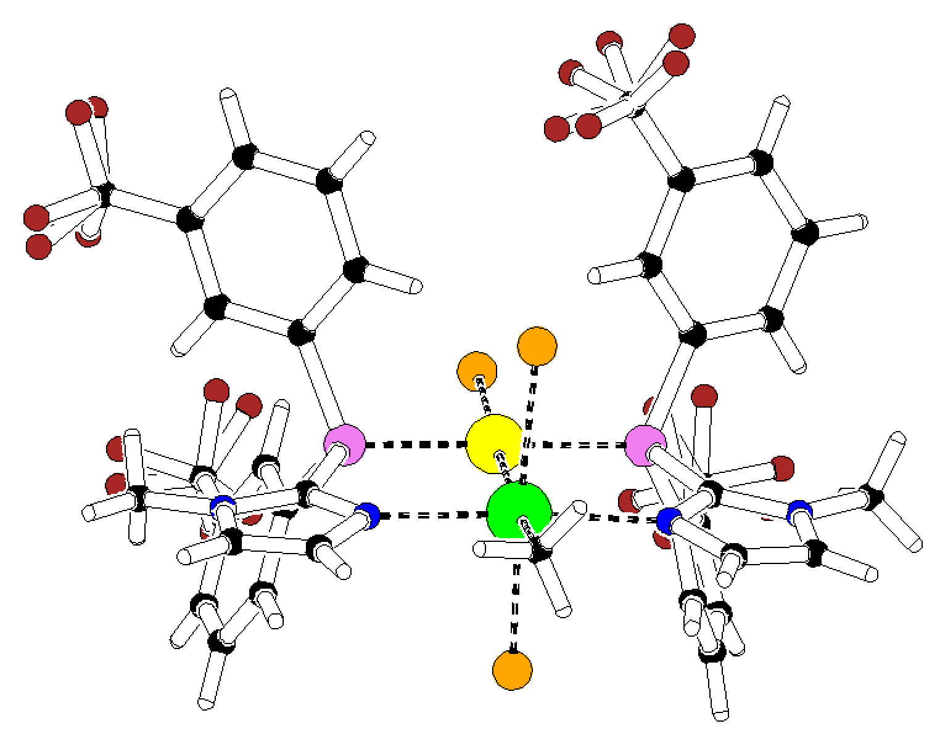
SQUEEZE-2016 EXAMPLE [Chem.Eur.J. (2015) 21, 1765]
Acetonitril Model: R = 0.0323, wR2 = 0.0889, rho(max) = 1.34 e/A-3
Space Group P2₁
Z = 4, Z’ = 2
60:40 Twin
Twin axis: (0 0 1)
150 K
TWINABS hklf5 data
Acetonitril solvate
Step 1 (SHELXL2014) ➔ R1 = 0.047, wR2 = 0.1445
Step 2 (SQUEEZE) ➔ 177 electrons found in unit cell
Step 3 (SHELXL2014) ➔ R1 = 0.0275, wR2 = 0.0679, S = 1.064

Slide 19
Effect of on R(F) before and after SQUEEZE as a function of sin(theta)/lambda

Slide 20
Requirements
There should be no residual unresolved density in the discrete model region of the structure because of its impact on the difference map in the solvent region. (may invalidate el. Count)
The data set should be reasonably complete and with sufficient resolution [i.e. sin(theta)/lambda >0.6].
There should be no unresolved charge balance issues that might effect the chemistry involved (e.g. The valency of a metal in the ordered part of the structure)

Slide 21
Limitations
The reported electron count in the solvent region is meaningful only with the supply of a complete and reliable reflection data set.
The SQUEEZE technique can not handle properly cases of coupled disorder effecting both the model and the solvent region.
The solvent region is assumed not to contain significant anomalous scatterers (Friedels averaged)

Slide 22
Reported SQUEEZE
Usage Statistics as
Prepared by the CCDC
Thank you !
a.l.spek@uu.nl
More info:www.platonsoft.nl
(including this powerpoint presentation)

