Slide 1
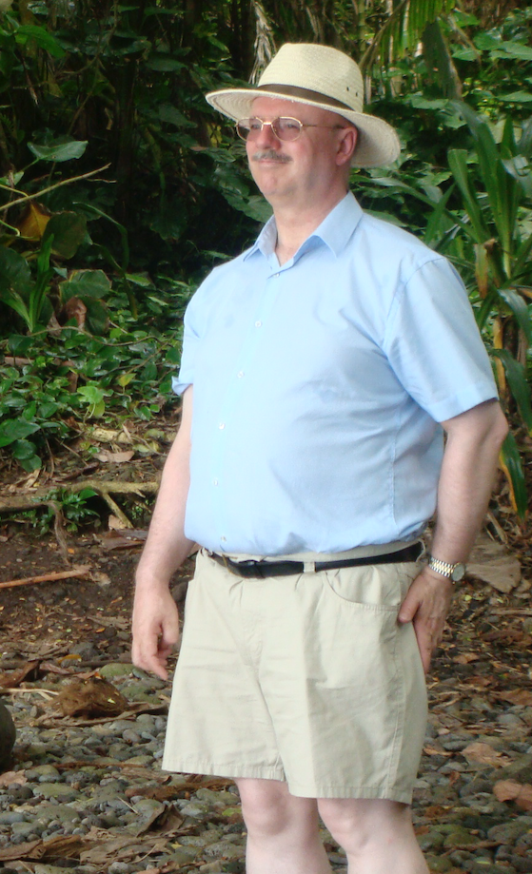
A Short History of Crystal Structure Validation and Tony’s Involvement in that Effort
Symposium on the occasion of the retirement of Prof. Dr Anthony Linden
Zurich, May 13, 2022
Ton Spek, Utrecht University, NL

Slide 2
Meetings
I think that I first met Tony and his wife Janet over lunch at the 1994 ACA crystallographic meeting in Atlanta, Georgia (USA).
I have enjoyed their company during many other meetings since then.
This resulted in memorable private after- conference trips such as in 2013 to the Big Island in Hawaii (with a nightly walk over the lava fields) after the ACA Honolulu meeting and a comfortable private roundtrip after the 2017 Hyderabad IUCr congress in India.

Slide 3
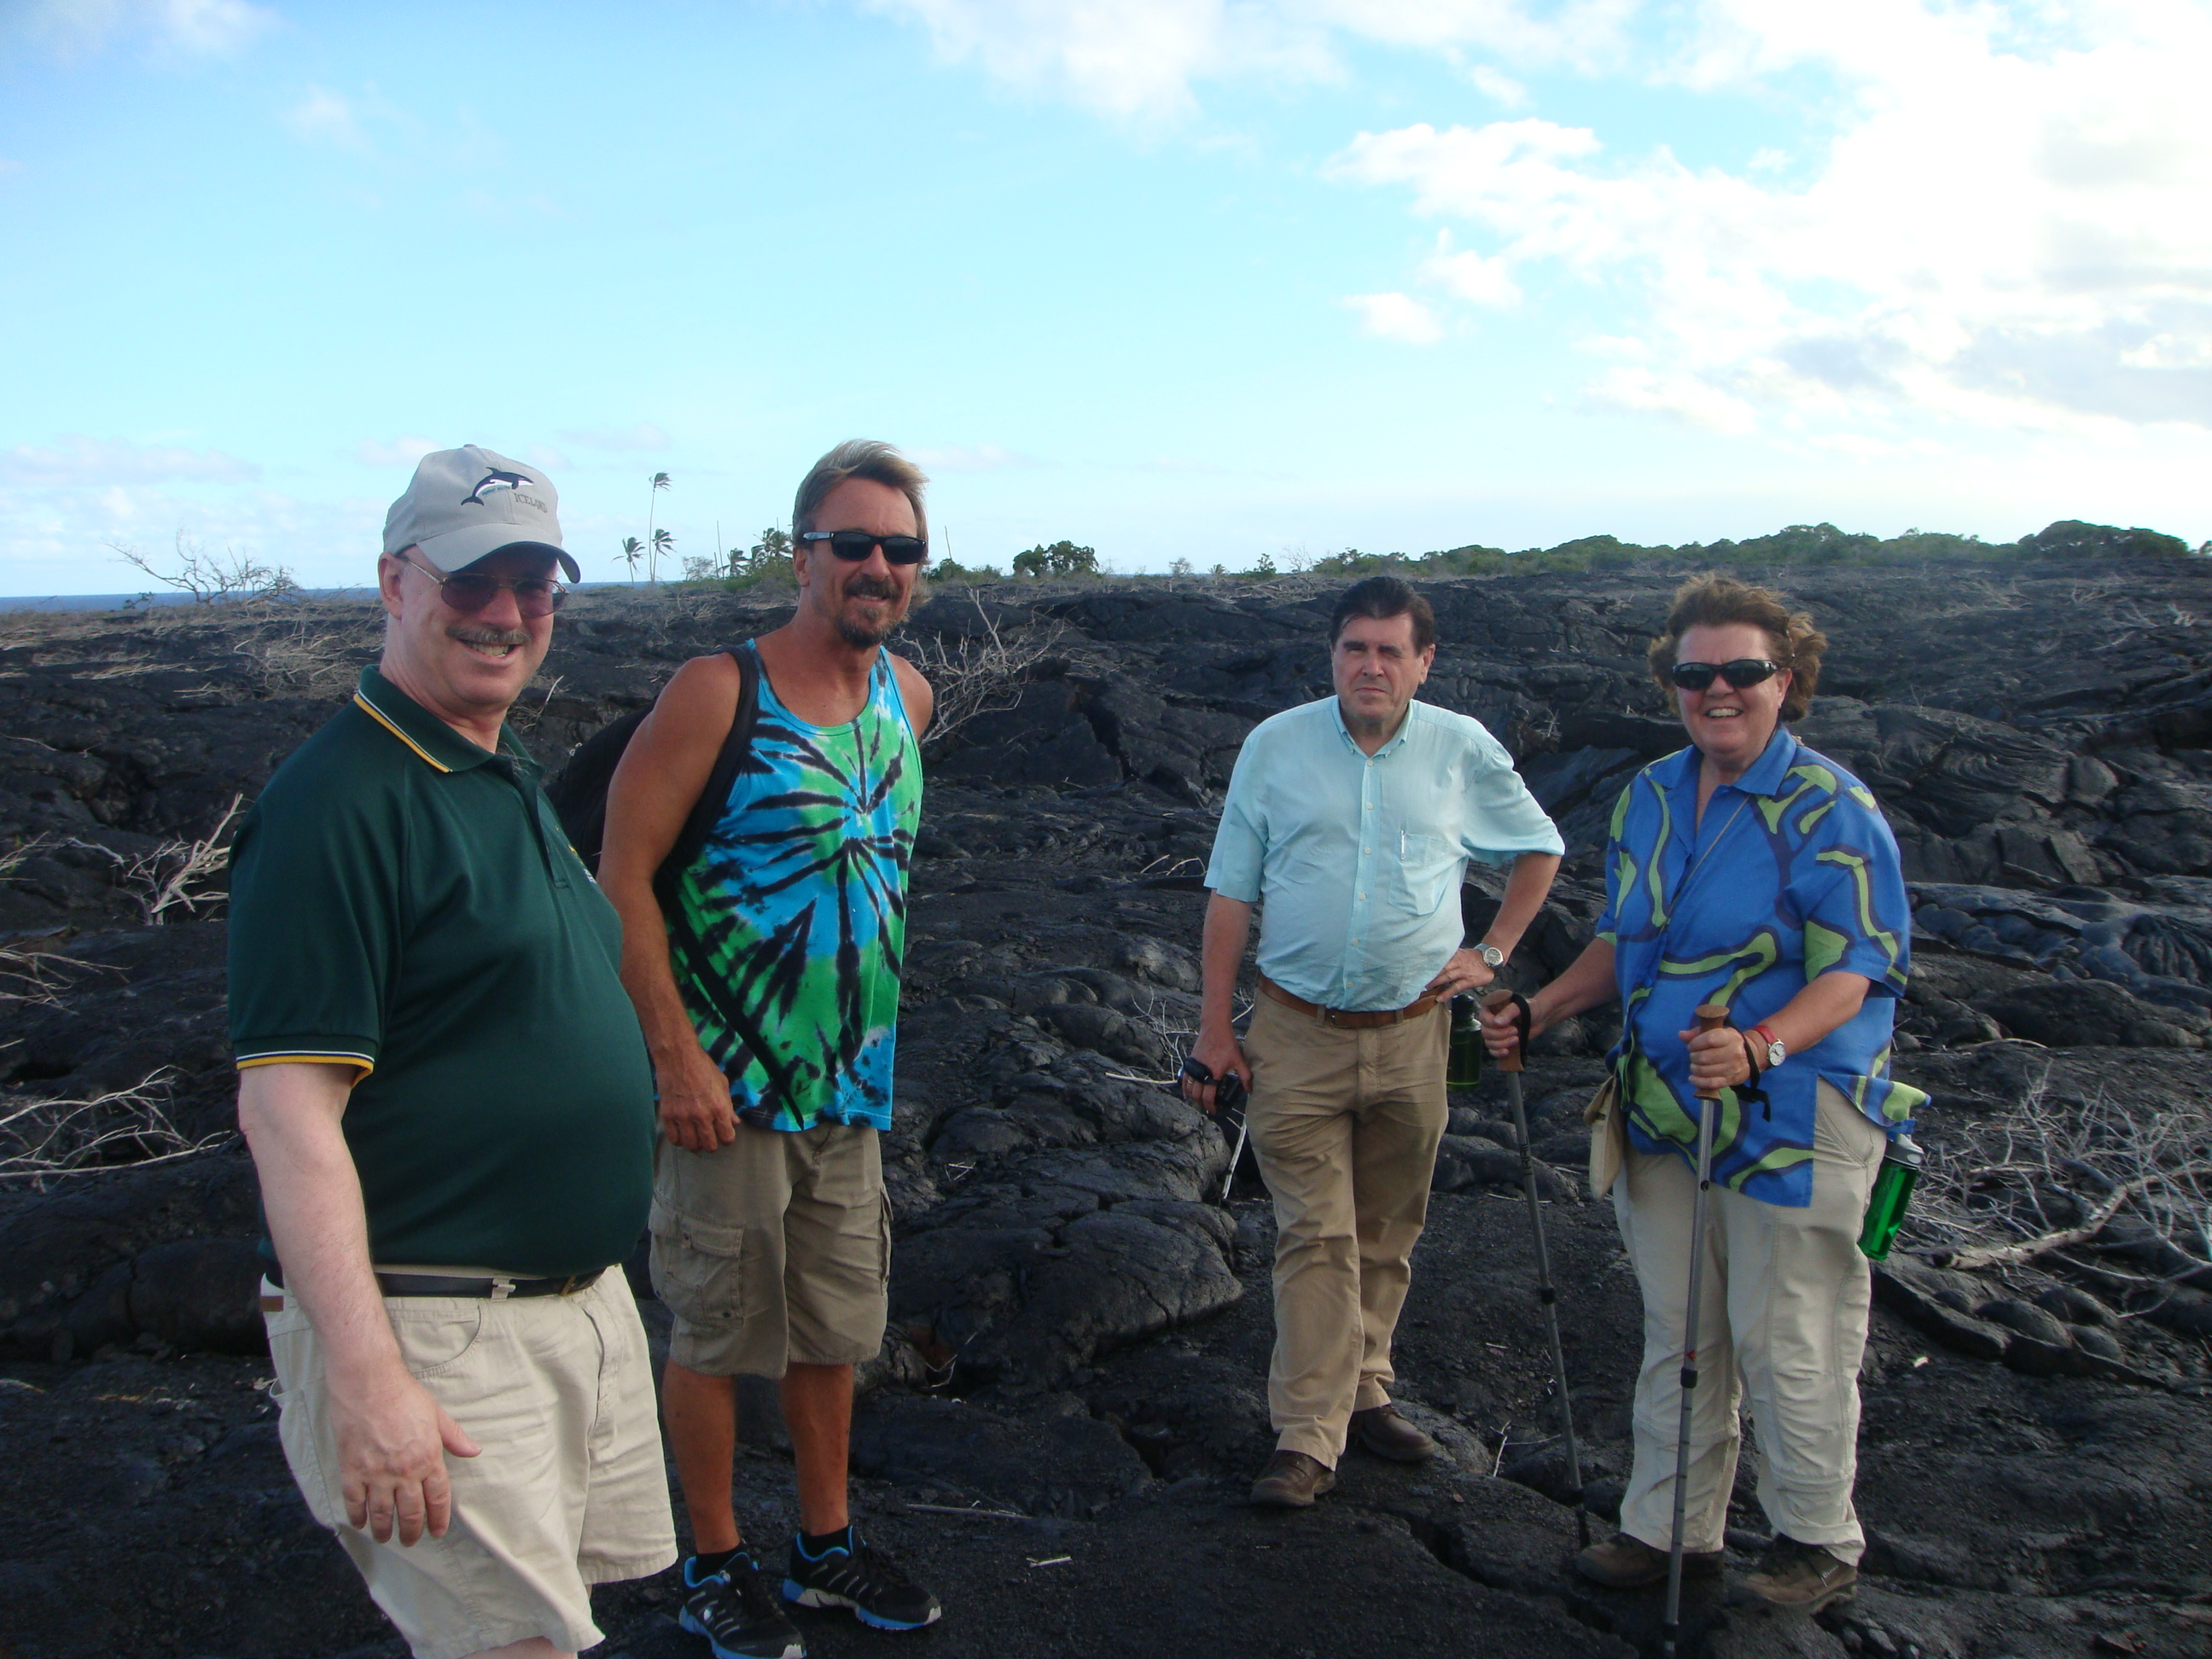

Slide 4
Tony Section Editor of Acta Cryst. C
In 2008, Tony took the section editorship of Acta Cryst. C over from George Ferguson
That increased my interactions with Tony as an Acta Cryst. C Co-Editor significantly, both about the A.C.C. papers that I handled and about structure validation issues.
Interestingly, Tony always managed to find residual issues in proofs (such as wrong figure numbers and textual issues) that I had missed in papers that I already had accepted.

Slide 5
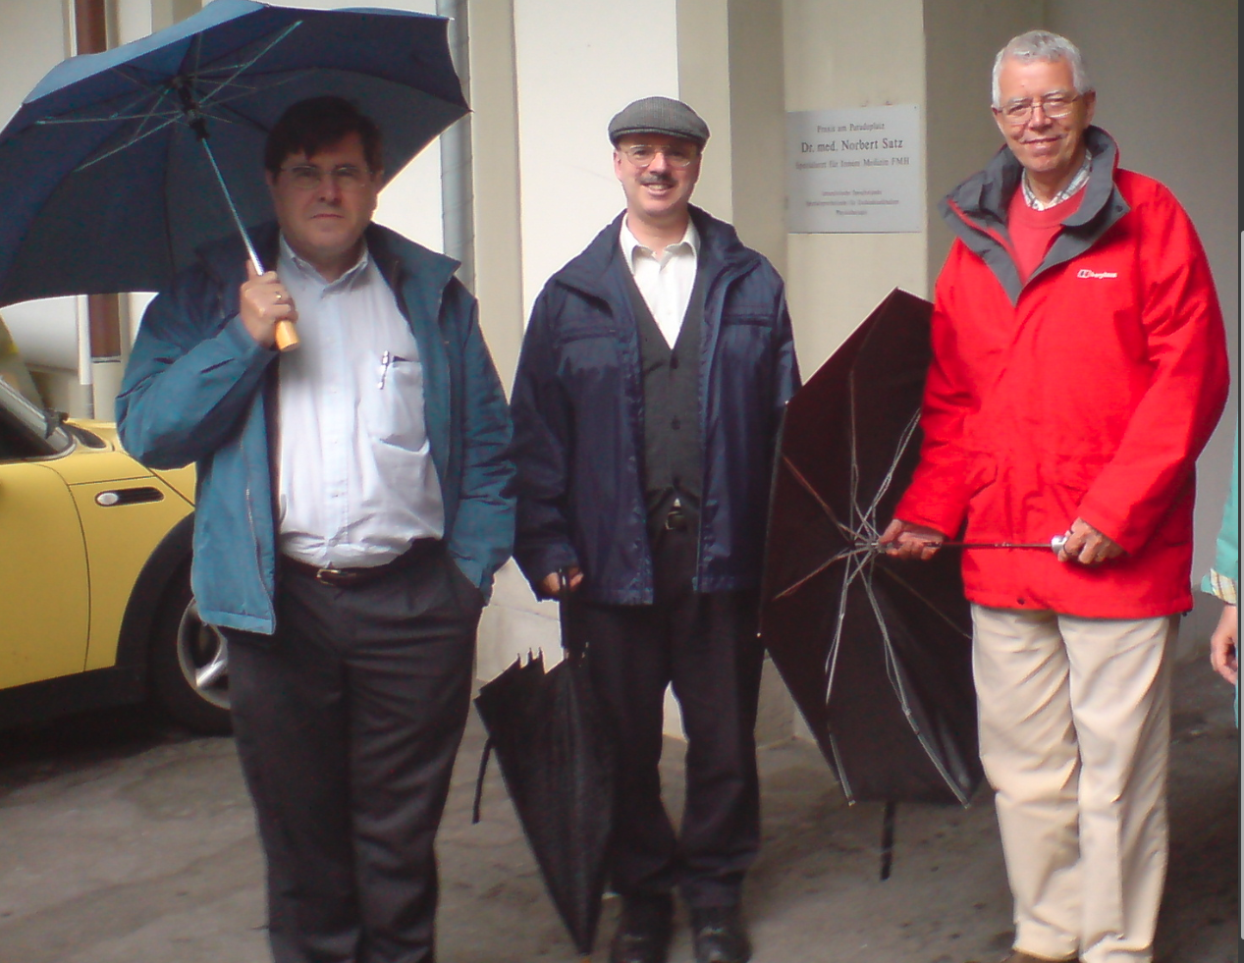

Slide 6
Structure Review in the Pre-checkCIF period (< 1995)
Multiple file formats and storage media
Review based on the printed material only (tables) in the manuscript
Limited access to the experimental data
Limited options to do additional calculations
Databases (CSD) had to cobble together the relevant data from the printed paper and correct for multiple typo’s and inconsistencies

Slide 7
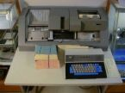
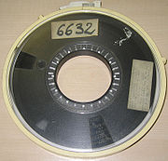
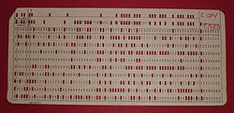
Data Storage when I started with crystallography in 1965

Slide 8
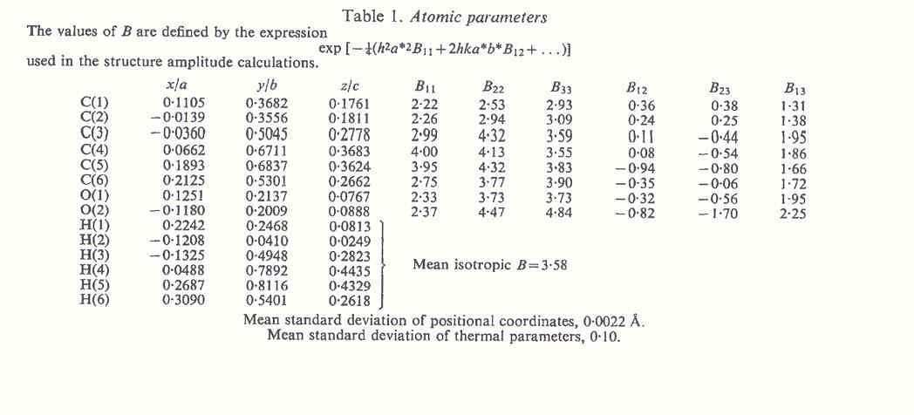
Archival of Crystal Structure Model Parameters in a Publication (Acta Cryst.)

Slide 9
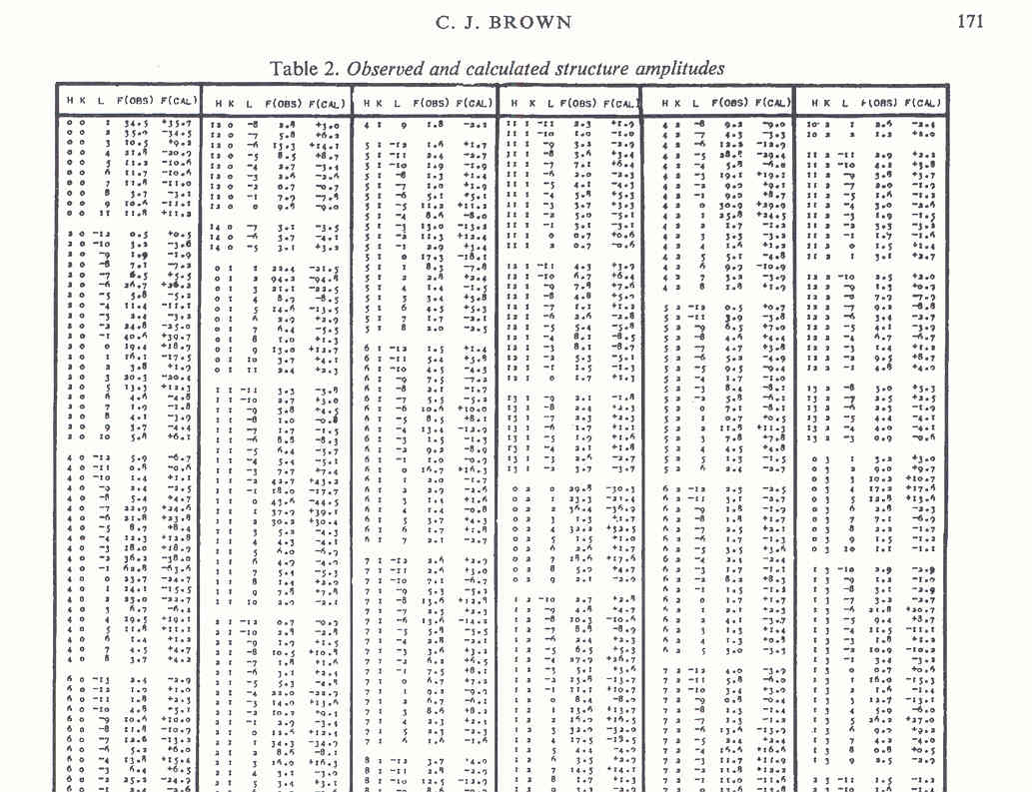
Archival of Reflection Data in a Publication (Acta Cryst.)

Slide 10
IUCr/checkCIF History
IUCr/checkCIF is now around for > 25 years
It was pioneered by the at that time section editor of Acta Cryst. C. , Syd Hall, as the main driving force.
It aimed at managing the review and processing of the at that time exploding number of manuscripts due to the wider availability of data collection, data processing and computing facilities
It depends on the computer readable CIF-standard for the archival and exchange of crystallographic data (Hall et al., 1991). DataName + DataValue, free format system
Syd Hall also managed to have CIF early adopted by George Sheldrick in the new release of his popular SHELXL refinement program. [Acta Cryst: > 90% Shelxl]

Slide 11
The checkCIF Report
Today, an IUCr/checkCIF report, as provided by the IUCr checkCIF server, is required as part of the refereeing process of any paper that includes a crystal structure.
The relevant structure analysis data are to be supplied in CIF data archival format.
The automatically created report lists issues that should be addressed as part of the refereeing process.
The report comes in the form of short ALERT messages.
Since the reported structure model represents the authors interpretation of the experimental data, also those experimental data and their processing have to be documented and made available for independent analysis of the structure determination.

Slide 12
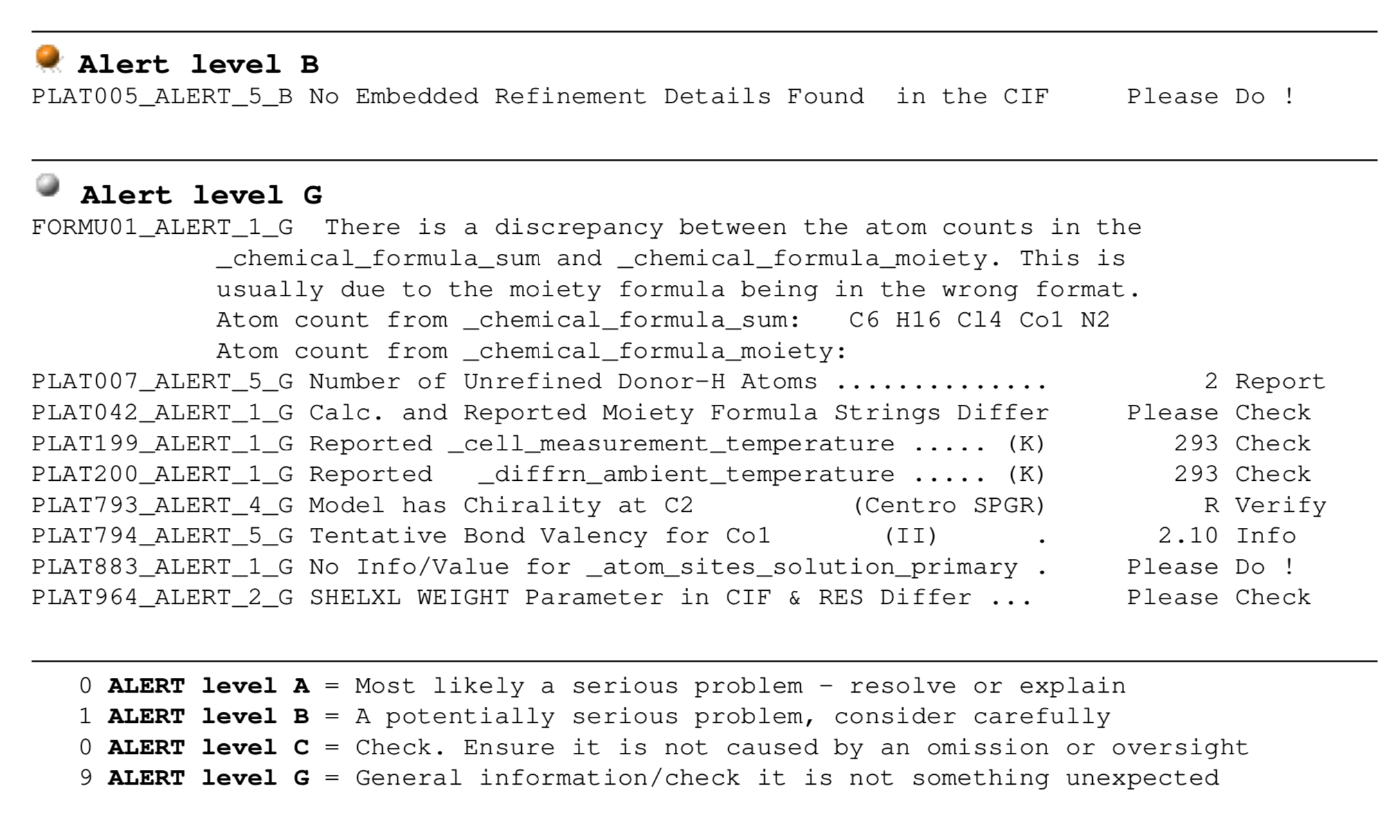
Example of an IUCr checkCIF Report

Slide 13
STRUCTURE VALIDATION AIMS AT PROVIDING INFORMATION ON ..
The quality of the data on which the study is based (i.e. based on the best attainable data quality or sufficient for the purpose of the study)
The quality of the refined model (i.e. all issues such as disorder resolved or sufficient to prove the structural features of interest)
Details on the experimental and data reduction and handling procedures used.
Messages about interesting, unusual, erroneous structural features

Slide 14
The ALERT set
The original set of ALERTS addressed issues such as completeness of the to be supplied information, data consistency, absorption correction, R values etc.
As co-editor, Syd Hall got me involved in the project by adding new ALERTS based on tools available in my program PLATON that address issues such as missed higher symmetry, solvent accessible voids and twinning
Many more ALERTS were added over time on the basis of newly detected (possible) issues. There are now over 500 implemented ALERTS. Some of the earlier ALERTS became obsolete and were removed.

Slide 15
ALERTS
A checkCIF reports consist of a list of compact ALERT messages with details to be found on the WEB
ALERTS originally had levels A,B & C on issues to be corrected or commented upon
G ALERTS were added later on with info/issues to be noted but not necessarily being an error
ALERTS starting with PLATxyz in the IUCr checkCIF report are created by PLATON and are appended to the (original) IUCr based ALERT set.

Slide 16
PLATON
PLATON is as single program with multiple tools that were found useful for our National Single Crystal Service Facility (> 40 years development)
A subset of those tools is used as part of the IUCr checkCIF facility for creating the review report
Additional PLATON tools can be used to investigate ALERTS as reported by IUCr/checkCIF
PLATON also includes its own checkCIF tool to be used locally during a structure determination to detect issues at an early stage of the analysis.

Slide 17
Benevits of checkCIF
Facilitates the review process
Sets quality standards
Helps to avoid pitfalls
Points to possibly interesting features of the structure
Assures that the reported/claimed result is reproducible on the basis of the provided information

Slide 18
Do Authors and Referees take Notice of/react on Validation ALERTS?
There was a wake-up call in 2010 with multiple cases in Acta Cryst. E where serious ALERTS related to faked structures were obviously not followed up during the refereeing process.
Published experimental data were ‘recycled’ and refined resulting in ‘exciting’ new chemistry.
As a result, there were 100++ retractions making authors, journals and referees more aware of validation issues.
At least Acta Cryst. now requires the archival of the unmerged reflection data in the CIF and has tools to identify possible fakes.
SHELXL automatically CIF-embeds the reflection data

Slide 19
Archived Experimental Data
Archived experimental data make it easier to analyse reported issues or to use them for unrelated research.
It makes re-refinement of a better/improved structure model possible
It may show that the experimental data are ‘invented’ (only rare cases up-to-now in the CSD)
It may show that a dataset is ‘recycled’ (see next dia) (e.g. with a I(obs)1 <> I(obs)2 plot

Slide 20
Observed data are identical for two structures with different CSD numbers

Slide 21
Is Everything now under Control ?
It looks like to be the case with Acta Cryst. papers
Unfortunately, recently a large number of frauded structure reports of a new type was detected by David Bimler
‘Papermill papers’ based on real/stolen published data combined with a fake non-crystallographic discussion and results section
Effecting in particular the biomedical domain

Slide 22
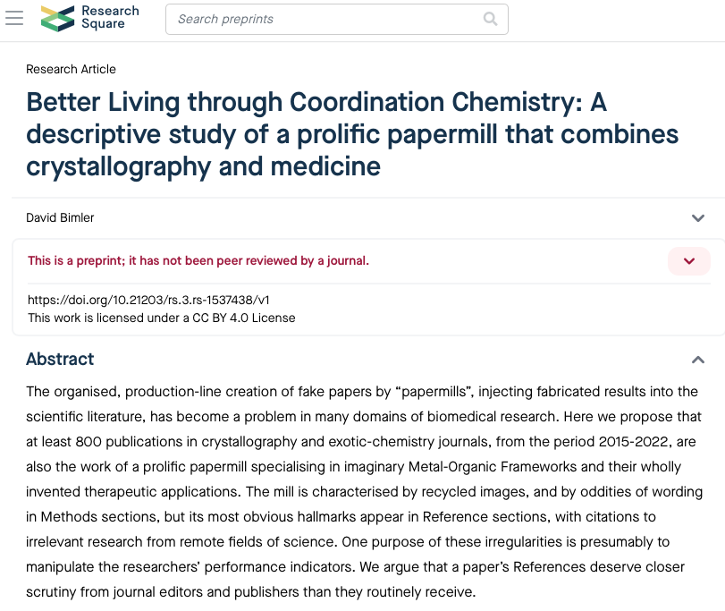

Slide 23
Follow-up
Close to 1000 suspect reports are now under investigation
The CSD has marked those as being under investigation
Published in journals like CrystChemEng, Inorg.Nano-metal.Chem,MaingroupChem
Obviously, the refereeing system of the journals involved is lacking knowledgeable referees in both crystallography and medicin to detect the fraud.

Slide 24
Concluding Remarks
Money and promotion seem to have been the driving force for many fake structure reports
The IUCr has set up an elaborate validation system of checks thanks to Acta Cryst. section editors like Tony
That checkCIF system is freely available for all users of crystallographic data
The CSD faces a large task to sort out the problem of ‘papermill’ publications.
How to automatically validate the results, discussion and reference section of a paper?

Slide 25
Retirement
Tony, thanks all the things we did together
Enjoy your varies hobbies that you plan to give more time from now on
I can assure you, based on my now close to 13 years ‘retirement’ experience, that time is still precious, even when ‘retired’
I and my wife Aggie, who could unfortunaly not attend, wish you good health and hope to keep in contact

